Slide 1

ECEN 3593-001 Computer Organization
Lecture #23
12 March 2021

Slide 2


Agenda
Class Announcements
Course Project
Chapter 1

Slide 3
Class Announcements
Reading Assignment
“Computer Organization and Design, The Hardware / Software Interface, RISC-V edition,” by David Patterson and John Hennessy
ISBN 978-0-12-812275-4
Chapter 1, “Computer Abstractions and Technology”
Sections 1.1 thru 1.11 required
Section 1.12 (optional)
pages 2-54
Homework #3 is graded and the solutions are enabled in Canvas.

Slide 4
Class Announcements
Phase 6 is in the deduction period – 4%/day
Phase 7 is posted – Target Date Sunday, March 21 at 10:00 PM
Bonus 1%/day (maximum 7%)
Deduction 4%/day
OH 2:00-3:00 today if requested in Slack by 2:00

Slide 5
Mid-Term
Mid-Term will be held in class on Wednesday, March 17
Mid-Term practice exam is posted
“Computer Organization and Design” text book, and RISC-V ISA specifications will be required for reference for figures as well as to create and decode RISC-V machine code
The Mid-Term will be taken through a Canvas quiz
50 minutes
1 attempt
Open Book, but not Open People, and not google

Slide 6
Mid-Term
Mid-Term compensation
4 questions similar to questions in homework #1 thru #3
Quiz bank of 12-18 questions
(estimating 30 minutes)
~50% of Mid-Term
15 multiple choice / matching questions
Quiz bank of 30-45 questions
Definitions / Theory based questions to test comprehension of the course material
(estimating 15 minutes)
~50% of Mid-Term
Suggestion: If you are stuck on a problem, make note of it and move on to complete other questions. Then go back and work on the problems that you passed over the first time
Do not lose the opportunity to complete questions that you know

Slide 7
Phase 7 - Decoder
ca_decoder is the CA equivalent of isa.codal
Elements (i.e. instruction groups) should correspond
There are several new control signals added in Phase 7
Total now is nine
All must have enums in ca_defines
Every element (including the existing ones) must assign an enum to every control signal
You must use these enums in the data path logic

Slide 8
Phase 7 - Schematics
The schematics should match your Codasip code
Use them to make sure your logic is right
Keep the STG_output blocks consistent for easy debug
Make sure the inputs and outputs of every register match (in the schematic and in the Codal code)
It’s then easy to look quickly to find many typos

Slide 9
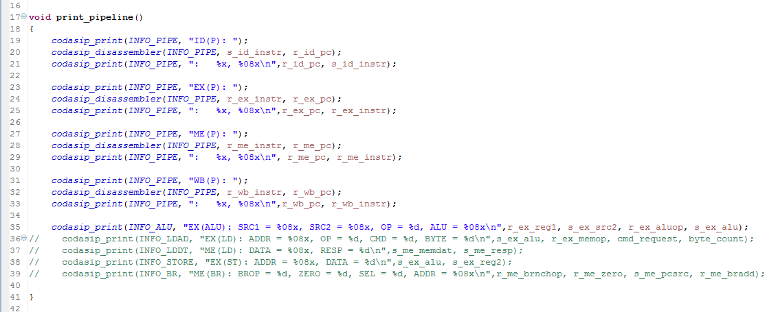
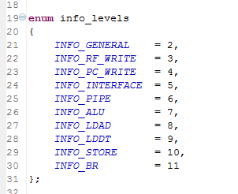
Class Project – Phase 7
Debug Prints (- -info)
In ca_utils.codal
Fix signal names
For - -info 7
Remove comment
For - -info 11
Print just before register updates
Can add your own prints
Levels defined in share/include/debug.hcodal

Slide 10
Class Project – Success of Phase 7
Test terminates on the very last nop
Register x25 contains 1
Register x10 contains 49
There can only be 11 enums for the s_id_aluop.
Some of these are defined in the document.

Slide 11
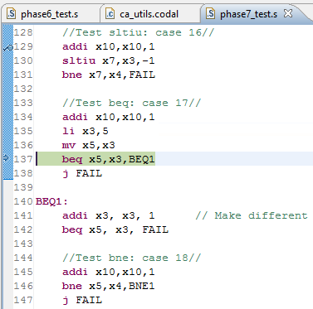
Phase 7 – Branch Behavior
Executing here
Will the branch be taken?
Yes
beq in IF

Slide 12
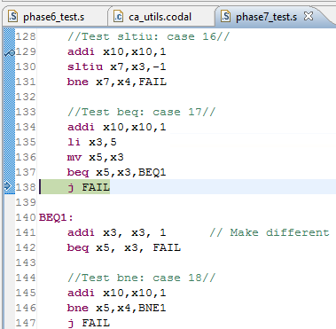
Phase 7 – Branch Behavior
Step
beq in ID
j FAIL in IF

Slide 13
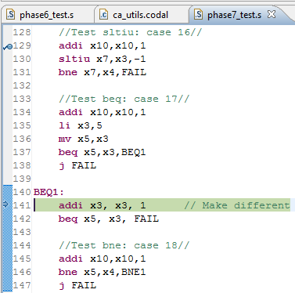
Phase 7 – Branch Behavior
Step
beq in EX
j FAIL in ID
addi in IF

Slide 14
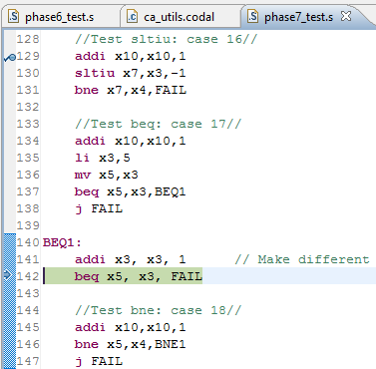
Phase 7 – Branch Behavior
Step
1st beq in ME
j FAIL in EX
addi in ID
2nd beq in IF
Now what happens?

Slide 15
Phase 7 – Branch Behavior
Step
Branch taken to BEQ1:
1st beq in WB
j FAIL flushed (nop in ME)
addi flushed (nop in EX)
2nd beq flushed (nop in ID)
addi in IF
Same instruction!

Slide 16
Phase 7
DEBUG, DEBUG, DEBUG

Slide 17
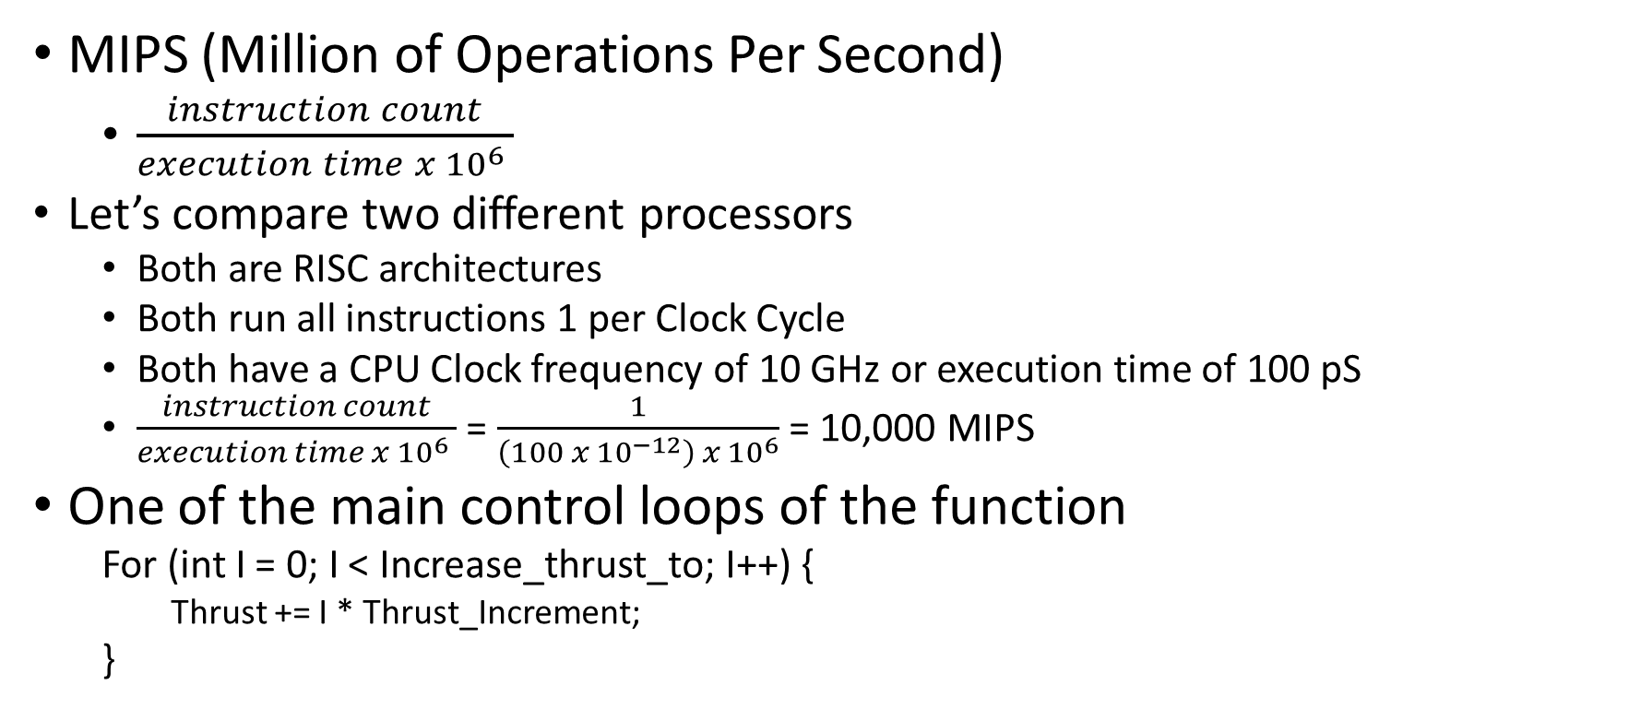
Performance Using MIPS
MIPS (Million of Operations Per Second)
$\frac{instruction count}{execution time x {10}^{6} }$
Let’s compare two different processors
Both are RISC architectures
Both run all instructions 1 per Clock Cycle
Both have a CPU Clock frequency of 10 GHz or execution time of 100 pS
$\frac{instruction count}{execution time x {10}^{6} }$ = $\frac{1}{\left(100 x {10}^{−12}\right) x {10}^{6}}$ = 10,000 MIPS
One of the main control loops of the function
For (int I = 0; I < Increase_thrust_to; I++) {
Thrust += I * Thrust_Increment;
}

Slide 18
MIPS
Processor A’s assembly code looks like:
Move x4, $zero
Move x1, Increase_Thrust_To
Move x2, Thrust
Move x3, Thrust_Increment
Beq x4, x1, At_Thrust
Loop: Mult x4, x4, x3
Add x2, x2, x4
Addi x4, 1
Bne x4, x1, Loop
At_Thrust:
4 instructions per loop
At 10,000 MIPS, this loop operates at 2,500 million times per second

Slide 19
MIPS
Faster (3,300 vs 2,500) but MIPS rating is the same (10,000)
Processor B’s assembly code looks like:
Move x4, $zero
Move x1, Increase_Thrust_To
Move x2, Thrust
Move x3, Thrust_Increment
Bqe x4, x1, At_Thrust
Loop: MAC x4, x2, x3
Addi x4, 1
Bne x4, x1, Loop
At_Thrust:
Mult x4, x4, x3
Add x2, x2, x4
=
3 instructions per loop
At 10,000 MIPS, this loop operates at 3,300 million times per second

Slide 20
Pitfall: MIPS as a Performance Metric
MIPS: Millions of Instructions Per Second
Doesn’t account for
Differences in ISAs between computers
Differences in complexity between instructions

Slide 21

MIPS
Processor B’s assembly code is shown below, but what if the MAC required 3 clock cycles to complete:
Move x4, $zero
Move x1, Increase_Thrust_To
Move x2, Thrust
Move x3, Thrust_Increment
Bqe x4, x1, At_Thrust
Loop: MAC x4, x2, x3 (3 clock)
Addi x4, 1 (1 clock)
Bne x4, x1, Loop (1 clock)
At_Thrust:
3 instructions per loop
but the average Clocks Per Instruction = $\frac{(3+1+1)}{3}$ = 1.67
At 10,000 GHz, this loop operates 2,000 million times per second
Still 10,000 MIPS but even slower

Slide 22
Pitfall: MIPS as a Performance Metric
MIPS: Millions of Instructions Per Second
Doesn’t account for
Differences in ISAs between computers
Differences in complexity between instructions
CPI varies between programs on a given CPU

Slide 23
FBQ
Submit to #phase7
First three correct answers after 5:00 today
10 bonus points in Phase 7
Can only win the Bonus once

Slide 24
Amdahl’s Law
Pitfall: “Expecting the improvement of one aspect of a computer to increase the overall performance by an amount proportional to the size of improvement”
The great idea of making the common case fast has a demoralized corollary
The opportunity for improvement is affected by how much time the event consumes or the number of times it is used
Amdahl’s Law: The performance enhancement possible with a given improvement is limited by the amount that the improved feature is used. It is a quantitative version of the law diminishing returns.

Slide 25
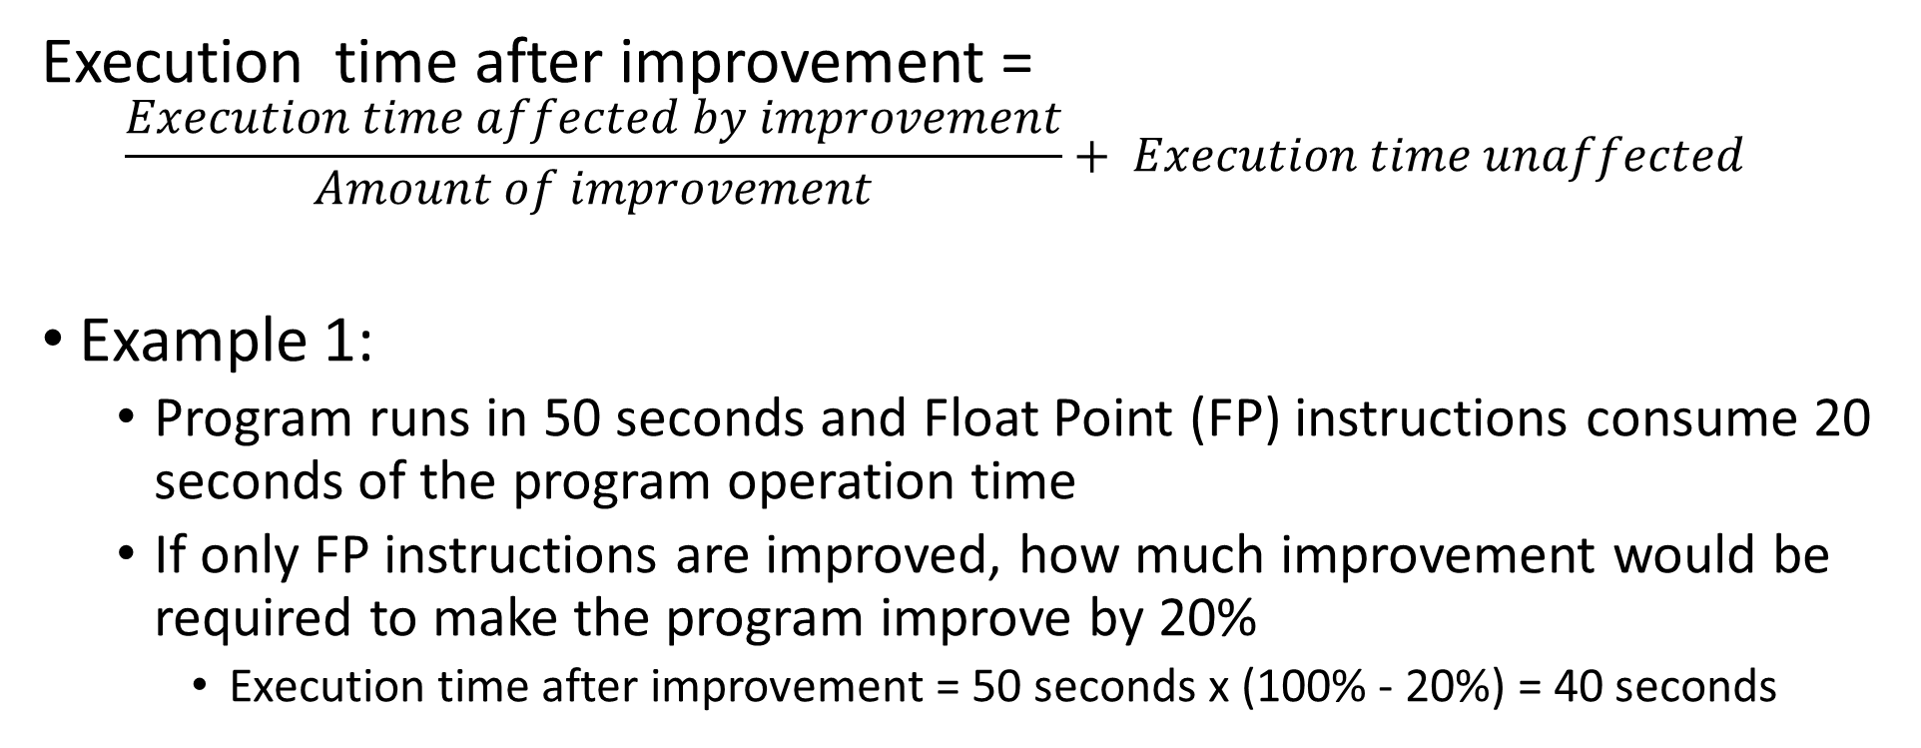
Amdahl’s Law
Execution time after improvement =
$$\frac{Execution time affected by improvement}{Amount of improvement}+ Execution time unaffected$$
Example 1:
Program runs in 50 seconds and Float Point (FP) instructions consume 20 seconds of the program operation time
If only FP instructions are improved, how much improvement would be required to make the program improve by 20%
Execution time after improvement = 50 seconds x (100% - 20%) = 40 seconds

Slide 26
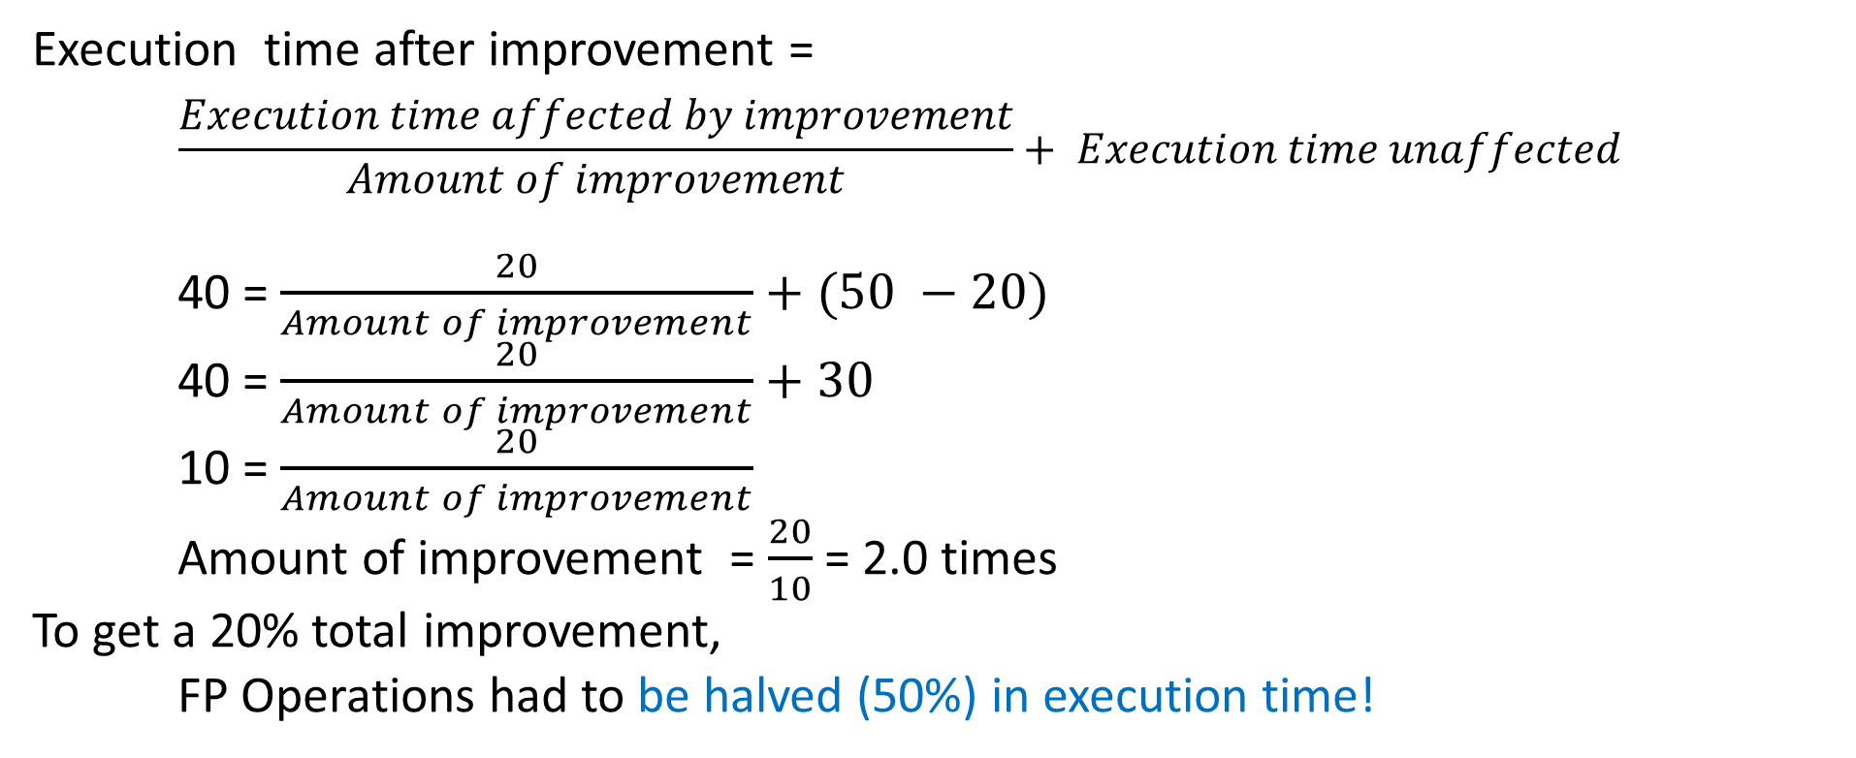
Amdahl’s Law
Execution time after improvement =
$$\frac{Execution time affected by improvement}{Amount of improvement}+ Execution time unaffected$$
40 = $\frac{20}{Amount of improvement}+(50 −20)$
40 = $\frac{20}{Amount of improvement}+30$
10 = $\frac{20}{Amount of improvement}$
Amount of improvement = $\frac{20}{10}$ = 2.0 times
To get a 20% total improvement,
FP Operations had to be halved (50%) in execution time!

Slide 27
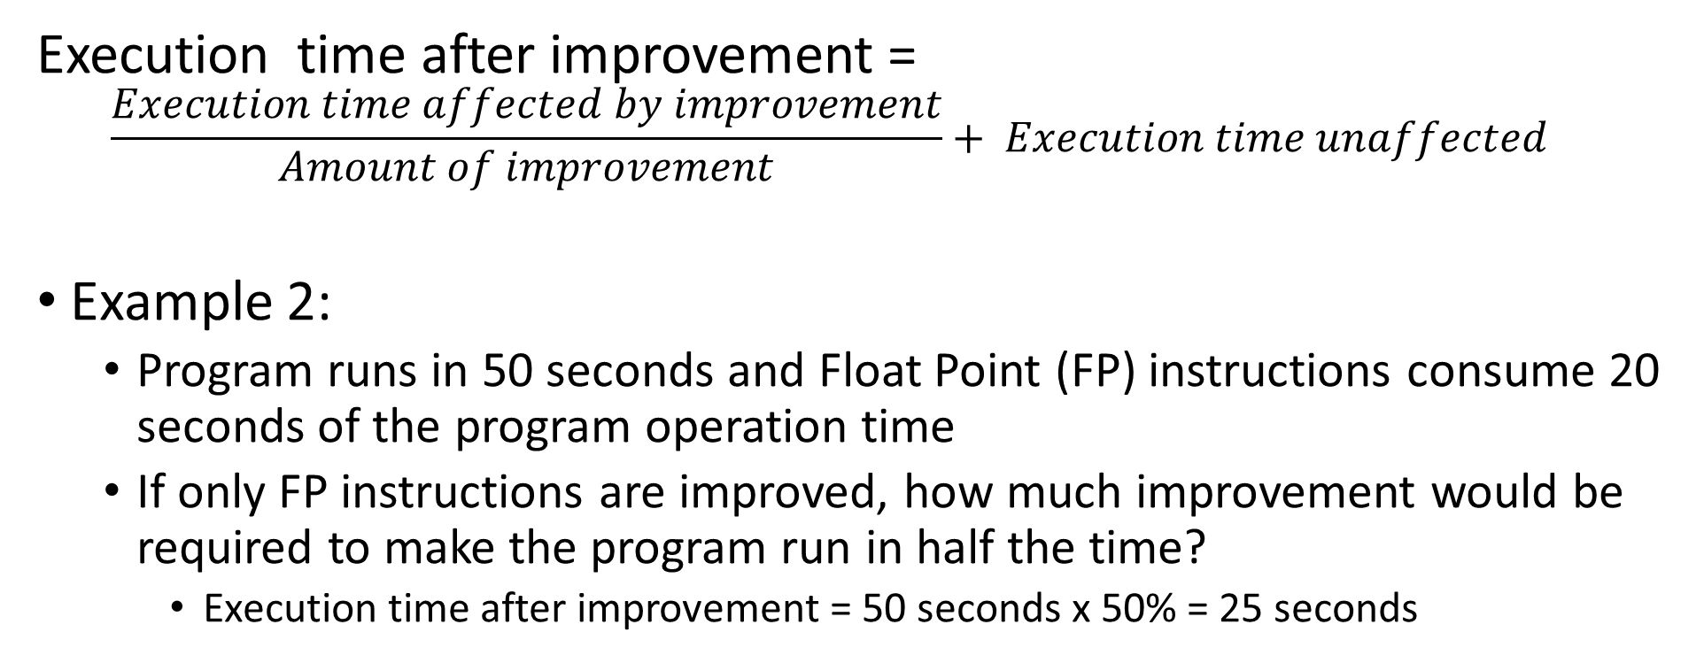
Amdahl’s Law
Execution time after improvement =
$$\frac{Execution time affected by improvement}{Amount of improvement}+ Execution time unaffected$$
Example 2:
Program runs in 50 seconds and Float Point (FP) instructions consume 20 seconds of the program operation time
If only FP instructions are improved, how much improvement would be required to make the program run in half the time?
Execution time after improvement = 50 seconds x 50% = 25 seconds

Slide 28
Amdahl’s Law
Execution time after improvement =
$$\frac{Execution time affected by improvement}{Amount of improvement}+ Execution time unaffected$$
Example 2:
Program runs in 50 seconds and Float Point (FP) instructions consume 20 seconds of the program operation time
If only FP instructions are improved, how much improvement would be required to make the program run in half the time?
Execution time after improvement = 50 seconds x 50% = 25 seconds

Slide 29
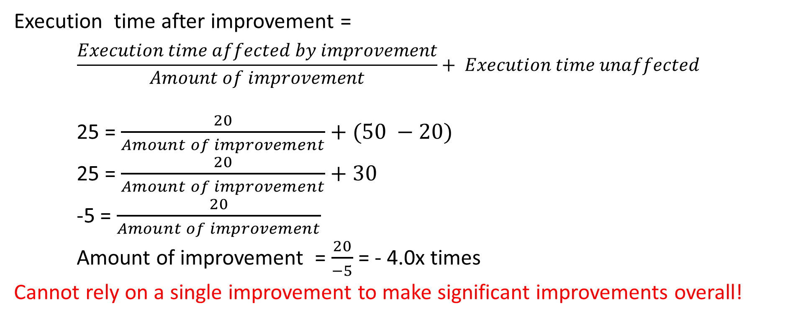
Amdahl’s Law
Execution time after improvement =
$$\frac{Execution time affected by improvement}{Amount of improvement}+ Execution time unaffected$$
25 = $\frac{20}{Amount of improvement}+(50 −20)$
25 = $\frac{20}{Amount of improvement}+30$
-5 = $\frac{20}{Amount of improvement}$
Amount of improvement = $\frac{20}{−5}$ = - 4.0x times
Cannot rely on a single improvement to make significant improvements overall!

